Slide 1
Compilation stages and runtime environment
October 2018

Slide 2
Agenda
Compilation stages:
Compilation process overview
C Preprocessor
Directives
Conditional compilation
Macro tricks
C Compiler + Assembler
Object file
Linker + Library manager
Linker Scripts
Debug vs Release
Runtime environment:
Program Loader
Program Segments
Text
Data
Heap
Stack

Slide 3
Compilation stages
EA 2018

Slide 4

Compilation stages overview
Header1.h
SW Guru
Header2.h
.
.
.
HeaderN.h
Source.c
Preprocessor
Source.i
Library1.o
.
.
.
LibraryN.o
Source.o
Debug/Release
Executable
Compiler
+ Assembler
Linker
+ Library Manager

Slide 5
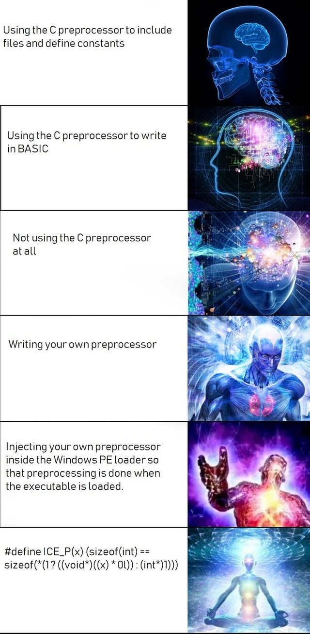
C Preprocessor
The C Preprocessing is the first step of the compilation process.
Provides own language – very powerful
Programs are easier to develop
Easy to read
Easy to modify
All preprocessor directives begin with #
#include
#define #undef #ifdef #ifndef
#if #else #elif #endif
#error #pragma #line #warning

Slide 6


C Preprocessor - #include
#include – the directive includes file into code
include file types – what kind of files can be included?
#include <file>
#include “file”
#include position in the file – beginning, middle, end? Inside functions?

Slide 7
C Preprocessor - #define
#define – substitutes a preprocessor macro
#define <macro> <replacement name>
Pros & Cons of using #define macro?
Pros
Easy to update
Good readability – eliminates magic numbers
Easy to port – the code itself is not updated, only the macro
Cons
Possible side effects
Hard to debug
Multiline macros (\)

Slide 8
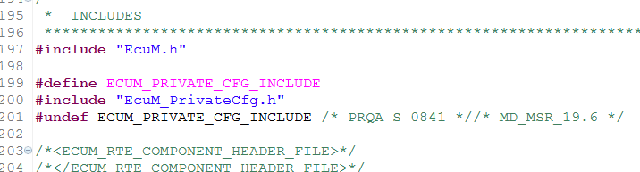
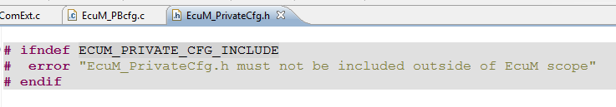
C Preprocessor - #undef
#undef – command which undefines a macro
It is used when it is needed to define a different value to an already defined macro. A macro must be undefined before being redefined to a different value
It is used as a key – defined, not defined to enable/disable some functionality

Slide 9
C Preprocessor – conditional compilation
Conditional compilation – feature which provides the possibility to choose which lines of code to be compiled and which not.
Enables code configuration during development
Enables code configuration during compilation
Enables debug specific checks
Enables headers guards
Preprocessor directives
#ifdef <identifier> – is true only when the identifier is already defined
#if defined(<identifier>) – is equivalent to #ifdef. Brackets are optional.
#ifndef <identifier> – is true only when the identifier is NOT already defined
#if !defined(<identifier>) – is equivalent to #ifndef. Brackets are optional.
#if <constant-expression> - is ‘if’ statement for the preprocessor
#elif <constant-expression> is ‘else if’ statement for the preprocessor
#else – is ‘else’ statement for the preprocessor
#endif – each of the above constructions must end with #endif

Slide 10
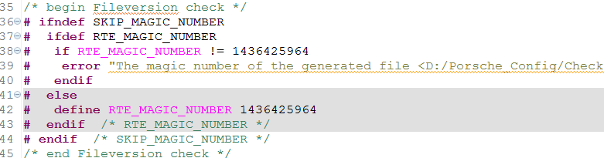
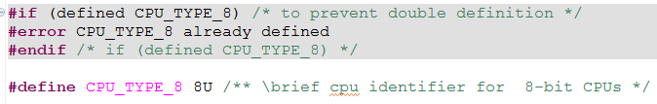
C Preprocessor – conditional compilation
Usage
#ifdef, #ifndef, #if, #else, #endif
defined

Slide 11


C Preprocessor – misc.
#warning
Usage – generates compilation warning on the line on which is placed
#error
Usage – generates compilation error on the line on which is placed
#pragma
Usage – special compiler directives
#line
Usage – changes the line number

Slide 12
C Preprocessor – macros for old farts
Passing Tokens (##) – Paste together two things between is ##
Object creation, complex macro creation, etc.
String-izing Tokens (#) – Converts the token to string
Debugging, complex macro creation, etc.
Useful macros
_FILE_
_LINE_
_TIMESTAMP_
_PRETTY_FUNCTION_ - is this a real macro?

Slide 13
C compiler + Assembler
Compilation process flow:
Compiler
Assembler
Source.i
Source.s
Source.o
Compiler – translates the “C” source code to another source code called assembler. The compiler is strongly specific for the platform you develop for:
Cross compiler
Compiler options
Intermediate genereted files – list file, debug file, etc.
Assembler – translates the assembler source code to compiled object file. The assembler is strongly specific for the platform you develop for.

Slide 14
Object files
File.o
Object file contains
machine compiled code
data for use by the code at runtime – stack info
relocation information (symbols) – a list of the places that have to be fixed up when the linker changes the addresses of the object code
names of variables and functions for linking
debugging information(optional)
Header
.TEXT
.DATA
.BSS
Debug info (optional)
Symbols

Slide 15
Linker
A program, which assembles all compiled object files to create an executable:
Merges and arranges the memory sections from compiled object files
Arranges objects in program’s address space
Adjusts code and data in the program to reflect assigned addresses
Replaces symbols with real data
Takes and composes needed objects from Library to put where needed (Library Manager)
Linker Script – the ld command language
Release vs Debug

Slide 16
Runtime environment
EA 2018

Slide 17
Program Loader
Source code file – *.c
C preprocessor
Preprocessed code file – *.i
C compiler
Assembly code file – *.s
Relocation object code information
Assembler
Object code file – *.o
Other object files/modules
Linker
What’s that?
Executable code – *.exe
Library files
Secondary storage (HDD)
Loader
Primary memory
(e.g. RAM)

Slide 18
Program Loader
Program Loader tasks:
Memory and access validation
Primary memory allocation for the program’s execution
Copying address space from secondary to primary memory
Copying the .text and .data sections from the executable into primary memory
Copying program command-line arguments on the stack
Initializing of registers: setting of the stack pointer to point the of the stack
Jumps to start routine: entry point _start
Source code file – *.c
C preprocessor
Preprocessed code file – *.i
C compiler
Assembly code file – *.s
Assembler
Object code file – *.o
Linker
Executable code – *.exe
Secondary storage (HDD)
Loader
Primary memory
(e.g. RAM)

Slide 19
Program Loader
Do a research for extra info;
What are the OS dependencies and differences – how is Unix different from Windows;
What’s special for the embedded systems;

Slide 20
Program segments
Program Segments
Address space contains program text, stack, and data sections (these three sections form the so called memory layout).
Heap – dynamic data segment. Dynamically allocated memory is allocated at run-time instead of compile/link time.
The process is an instance of a program - the OS has loaded the .exe file, arranged it to have access to its cmd arguments (and environment variables). The program is running.
A process has the following memory allocated areas:
Executable file section | Address space segment | Program memory segment
.text | Text | Code
.data | Data | Initialized data
.bss | Data | BSS
- | Data | Heap
- | Stack | Stack

Slide 21
Program segments
Overview
High
memory address
Stack
Heap
Stack
user
BSS
Uninitialized data
Data
Initialized data
Code
Instructions
OS Kernel
kernel
Low memory address

Slide 22
Program segments
Code – text segment
The executable instructions reside here.
This region could be sharable – multiple running instances of the same program share their code if possible.
This segment is often read-only in order to prevent the program from modifying itself.
malloc.o (lib*.a)
printf.o (lib*.a)
Library functions if statically linked
Text
(compiled code, a.out)
file.o
main.o
The return address
Startup routine

Slide 23
Program segments
Initialized data – data segment
Portion of virtual address space of a program, which contains the global and static variables that are initialized with nonzero values.
Every process running the same program has its own data segment.
data
Global variables
int x = 10;
Initialized data - data

Slide 24
Program segments
Uninitialized data – data segment
Also called BSS segment (block started by symbol)
Data in this segment is initialized by the kernel to arithmetic 0 before execution
BSS starts at the end of the data segment and contains all global and static variables, that are initialized to zero or do not have explicit initialization
Each process running the same program has its own BSS area.
For Linux/Unix – only variables that are initialized to a nonzero value occupy space in the executable’s disk file
Global variables
Uninitialized data - BSS
int x = 10;
Initialized data - data

Slide 25
Program segments
Heap
The area where memory, obtained by malloc, calloc, realloc, new (C++), comes from.
Everything on the heap is anonymous – you can access its parts only through a pointer
Begins at the end of the BSS segment and grows to larger addresses from there.
It’s possible to give memory back to the system (the process address space becomes smaller), but it will be most probably allocated to other process again.
The end of the Heap is marked by a pointer, called break. Past it the address space cannot be referenced. This pointer could be moved by brk or sbrk system calls.
Shared libraries
malloc.o (lib*.so)
Library functions if dynamically linked
printf.o (lib*.so)
For heap growth
brk() point
Heap

Slide 26
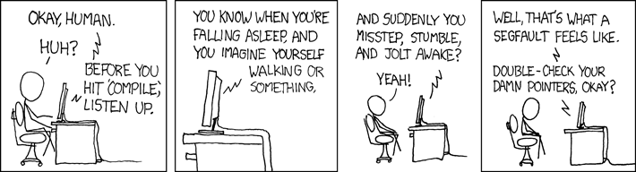
Program segments
Heap
Keep the heap clean:

Slide 27
Program segments
Stack
The stack area contains the program stack – a LIFO structure, typically located in the higher parts of the memory. On x86 architecture it grows toward $0. On some new architectures it grows the opposite direction.
The stack pointer tracks the top of the stack and its values is being pushed onto the stack.
The set of values pushed for one function call is termed a stack frame
The stack holds local variables, temporary information, function parameters, return addresses and etc.
System
env
argv
argc
Stack
main() frame pointer (EBP)
Local var for main()
Local var for func()
Stack pointer (ESP) points at the top of the stack and grows downward
For stack growth

Slide 28

Program segments
Stack

Slide 29
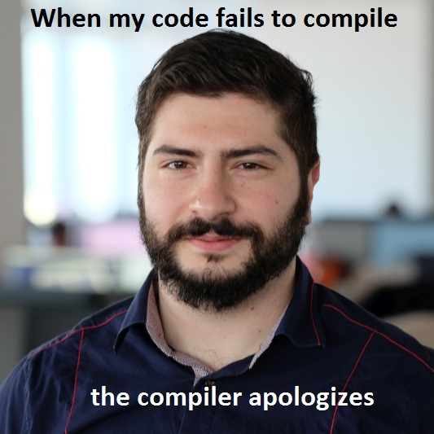
Resources
dandree2@visteon.com
Engineering Academy Crew

